Slide 1



Home
Login
Register
Welcome to Al Imam Daycare site
Home Page
Enrollment periods
Opening period First Week
Closing period End of the first month
Ne
Copyright All Right Reserved @ 2022

Slide 2
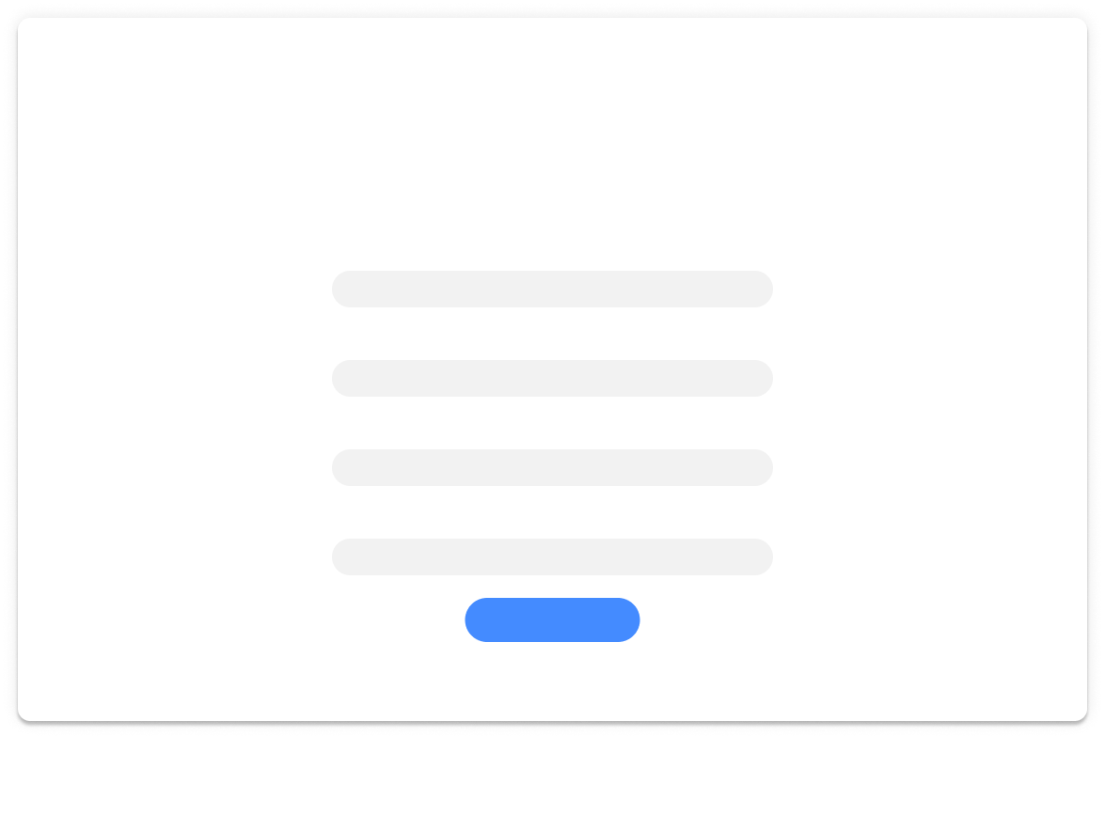
Al Imam Daycare site
Home
Login
Register
Register Page
Username
Email
Phone Number
Password
Sign Up

Slide 3
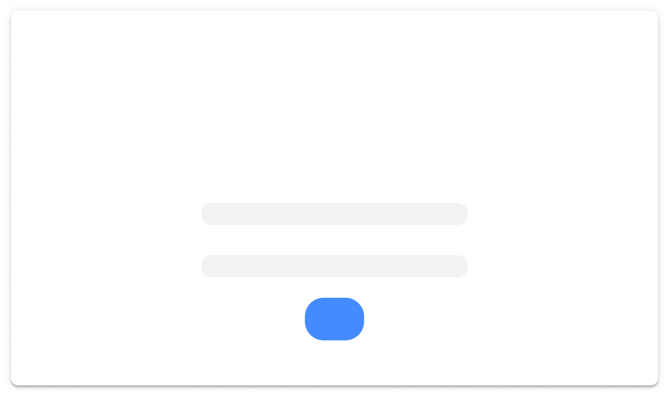
Home
Login
Register
Al Imam Daycare site
Login page
Username
Password
Login

